Slide 1


Running on Full
Strategies for managing the demands of multiply roles
Dr. Karen MacNeill, Ph.D, R.Psyc

Slide 2


Slide 3
Running on Full- what’s in it for you?
Shift in ways of thinking about ‘work-life-balance’
Recognize warning signs before major issue arise
Develop strategies on how to build energy/resources needed to manage the demands of multiple roles

Slide 4
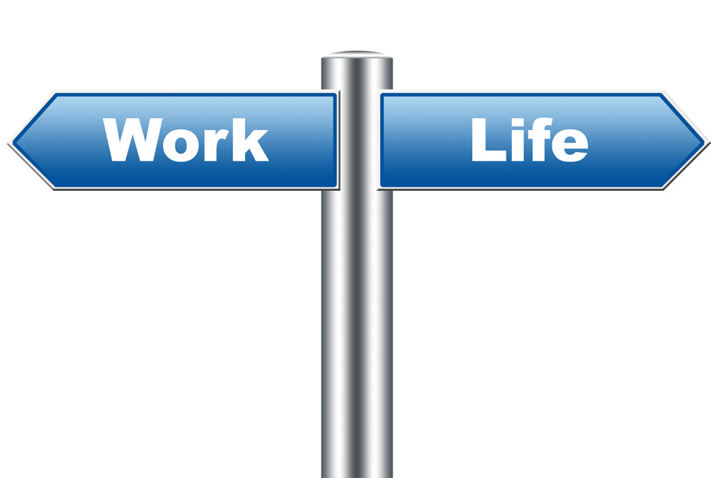
Work-life-balance
Balance between an individuals work and non-work life.
Focuses on the issue of conflict vs. enrichment
Goal is to minimize conflict
Dismisses the positive role work plays to produce energy and enrich other life domains
What is balance…. And is it possible?

Slide 5
Personal Resource Allocation
- Grawitch et al., 2010
Personal Resource Supply (time, energy, money)
-Both actual and perceived
Demands on Resources
- Required vs. Preferred
Resource Allocation
-Deliberate choice of where, when, and how
Individual Outcomes
- Future resources, subjective well-being, Performance

Slide 6

Effective Resource Allocation
Awareness of resource supply
  Energy makers
  Energy takers
Manage perception of demands
  Threat vs. opportunity
  Develop required competency/ skill needed to respond to demand
  Manage expectations/noise
Deliberate choice about where/when/how to expend resources

Slide 7
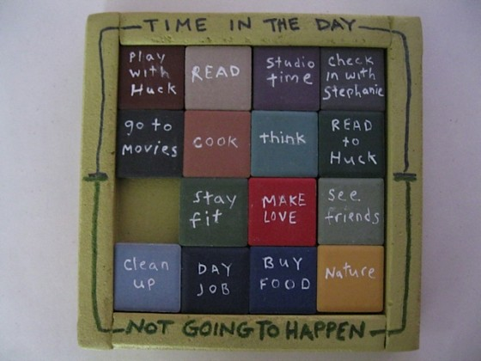

Shift in thinking….
“Having it all”
“Having what is most important”

Slide 8
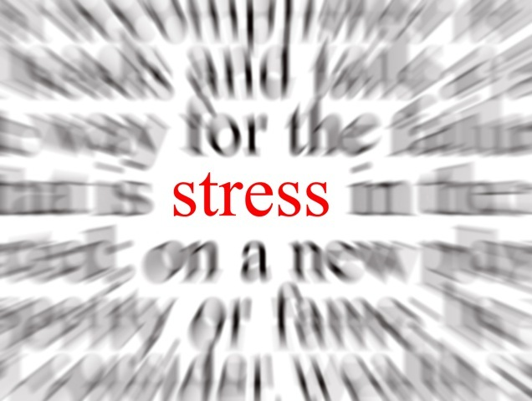
Stress
An imbalance between perceived demands and perceived resources
Individual process involving an interaction between:
  Person (biology, behaviors, and emotions)
  Environment (demands)
  Appraisal (thoughts)
  Resources (coping strategies)

Slide 9
How does stress manifest?
Body- physical | Emotions | Behaviors | Mind- thoughts
Fatigue/Tiredness Muscle tension Racing heart Shortness of breath Upset stomach Sleep problems Change in appetite Headaches High blood pressure Cold hands/feet Sweaty palms Weight loss/gain Other: | Frustration Anger Worry Irritability Loss of self-esteem Helplessness Sadness Anxiety Other: | Avoidance Performing with caution Over-functioning Increase caffeine Substance abuse Crying Social Isolation Yelling Aggressiveness Other: | Poor concentration Mind racing Doubt in ability Difficulty making decisions Slowness in thinking Memory problems Catastrophic thoughts Other:

Slide 10
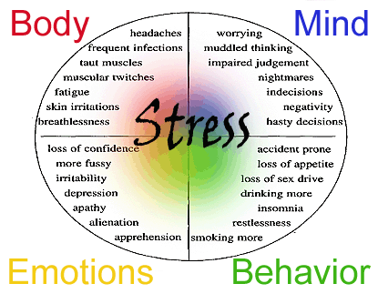
What are your stress signs?
____________________
____________________
____________________
____________________
____________________
____________________
____________________
____________________

Slide 11

Warning signs
Anything persistent and outside “the norm”- extremes
Increase sickness and persistent fatigue
Avoidance tactics (passive/active)
Emotional instability, persistent overwhelm, and low self- esteem
Decrease in performance
Relationship difficulties
Unhealthy behaviors

Slide 12



Monitoring
Health, well-being, and performance indicators
Fatigue: How is my energy level?
Sleep: Have I been getting enough sleep? Do I feel adequately rested?
Health: How is my general health (free for illness/injury)?
Emotional stability: How is my emotional state and irritability?
Stress: How is my stress level and feeling of overwhelm?
Performance: How has my work performance and task execution been?
Relationships: How are my relationships with others?
Behaviors and coping: How are the behaviors I am choosing to use to cope with my demands (healthy, adequate etc.)

Slide 13
Impacts health, well-being, performance
Chronic activation of our nervous system with little respite from stress hormones causes potentially serious problems with the following:
Physical Health- hypertension, asthma, ulcers, heart/vascular issues, IBS, suppresses immune
Mental Health- depression, anxiety, decrease well-being
Relationship health- increase conflicts, interpersonal and relationship issues
Behavioral heath- lifestyle choices (alcohol and drug use), eating choices, decision making, spending behaviors etc.
Performance- issues with job performance, problems with executing tasks

Slide 14
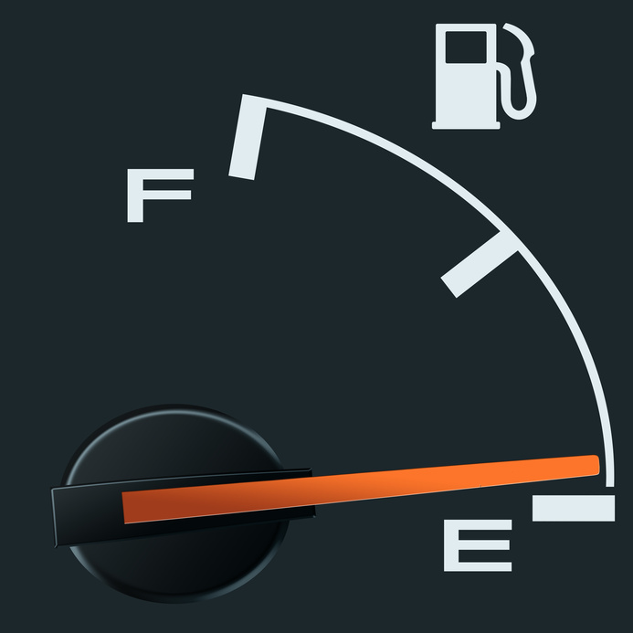

Strategies
Active Awareness
Deliberate Choice
Renew energy
Build your team

Slide 15
Active Awareness
+
Conscious
Incompetence
Conscious
Competence
Conscious Choice
Unconscious
Incompetence
Unconscious
Competence
.
Consciousness
Habit
_
_
Competence
+

Slide 16

Deliberate Choice
Identify what really matters most
Be strategic- prioritize and plan
Actively allocate resources by choosing when, where and how

Slide 17
Renew Energy
Create daily habits to renew energy in the bodies four main energy sources
Spiritual energy renewal
Sense of purpose, time with family
Mental energy renewal
Focus ‘chunks’, micro breaks, recovery
Emotional energy renewal
Breath, perspective, let go
Physical energy renewal
Sleep, nutrition, exercise
Loehr & Schwartz, 2009

Slide 18

Build your team
Identify sources of support
Delegate and task share
Build team of experts/ mentors to help guide you and develop skills/tools needed

Slide 19
To ‘Run on Full’…
Shift mindset from ‘having it all’ to ‘having what matters most’
Become actively aware of stress signals- be proactive vs. reactive
Be strategic about managing energy and resources

Slide 20
Questions??
For more information:
kmacneill@copemanhealthcare.com

