Slide 1
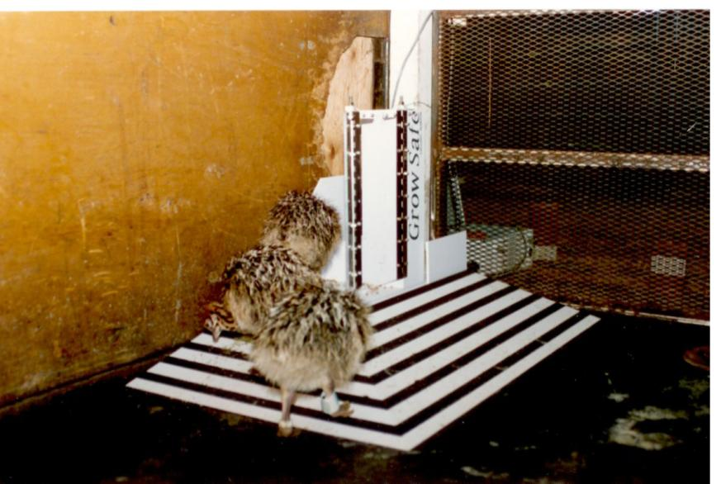
GrowSafe Founded in 1990
First to Tag Production Livestock
Met Founder Camiel Huisma in 1999
Invested in company in 2000

Slide 2
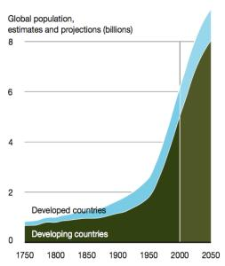
Beef Industry
By 2050 – Must Feed 9 Billion – Same Land
Under significant pressure from
  Rising input costs
  Consumer concerns about:
    Beef safety, carbon footprint
    Animal welfare, disease, antibiotic use
2020
MEAT
DEMAND
55%
Source: UNEP
Need to Do More with Less Sustainably – Need Disruptive Innovation

Slide 3

GrowSafe Systems
Engineers Computer and Animal Scientists
“Big Data” Acquisition Analytics Platform
Applications for the Livestock Production Chain
Seedstock - Efficiency
Feedlot - Profitability
Cow Calf, Dairy, Sheep Sustainability
Measure Monitor Predict Mitigate Optimize

Slide 4
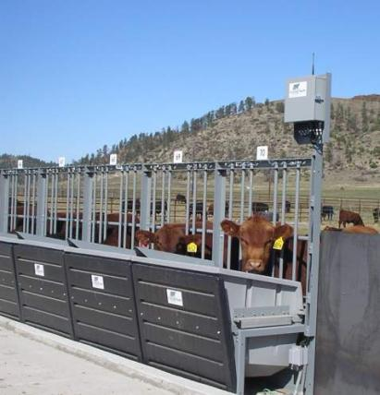
1st Application Seedstock
GOLD STANDARD
Animals are tagged with RFID tag
Data is collected every second
  ~ 20 Million datapoints each day
Measures and automatically reports
  individual feed intake and behavior for each animal every day
Snyder Livestock, Nevada

Slide 5
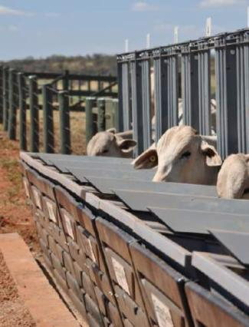
Residual Feed Intake (RFI)
Rancho da Matinha - Brazil
Measured FI - Expected FI = RFI
Selection for RFI reduces ¹
Feed Intake - 12%
Methane - 30%
Manure NPK -17%
Cattle Per Animal Savings:
Feedlot = $60+ per 120d
Dairy = $330+/cow/lactation
¹ Agrifacts

Slide 6
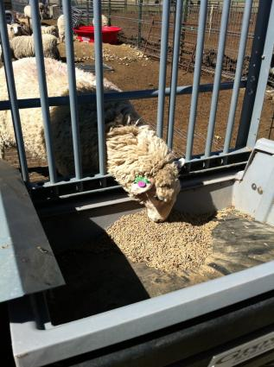
GrowSafe RFI Testing
Where
100+ installations
23 US States
7 Canadian Provinces
9 AB Sites
Mexico
Australia
United Kingdom
Finland
Uruguay
BRAZIL
Tullimba Feedyard - UNE
Simplot Land & Livestock - Idaho

Slide 7
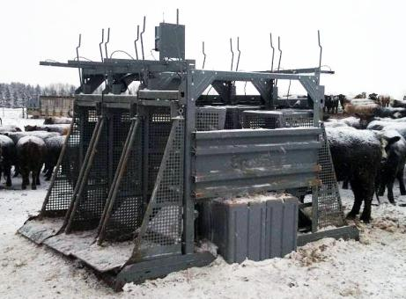
2nd App - Feedlot - GrowSafe Beef®
In Pen Measurement Unit
Data acquired when animal drinks:
Non-invasive
RFID and data from multiple environmental and biometric sensors
Animals weighed, water intake measured
GrowSafe Beef®
Always Connected to GrowSafe

Slide 8
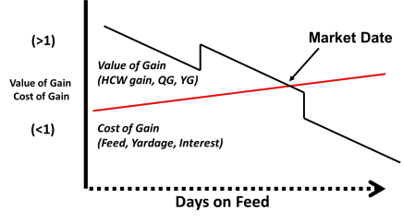
Software ‘Learning’ Algorithms
Reports daily weight and growth statistics
Digitally profiles animal health
  ID sick 4d+ adv clinical symptoms
  24 hrs adv body temp change
Determines optimum market time
  When COG=VOG
More Data – More We Learn

Slide 9
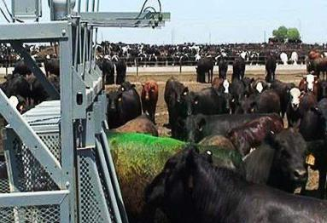
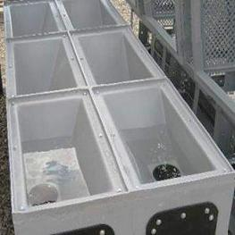
Targets Health Outliers
System Triggers:
Marking
Medicating
Up to 4 Water Soluble Products

Slide 10




Unprecedented ability in real-time to:
Continuously and automatically track animals
Identify disease before symptom expression
Measure, predict future gain and market value
Treat individual animals without human intervention
Case Study
Intel® Core™ i7-3770 processor
Intel® Xeon® processor E5-2403
Small Business - Agribusiness

Slide 11
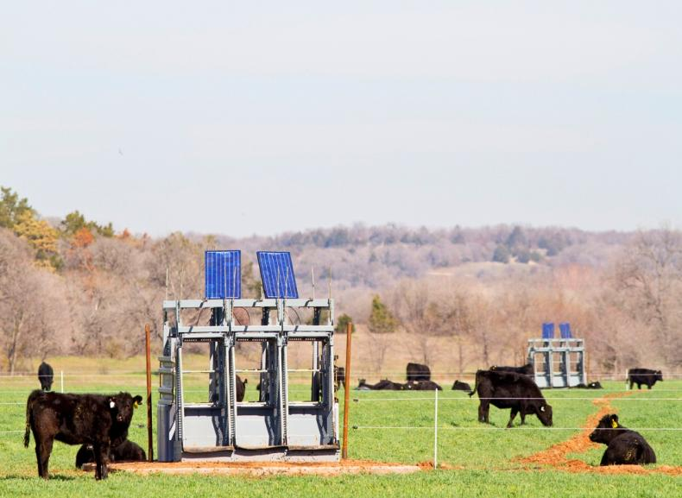


















Our Pride:
Profitable, No Debt, Invest in R & D
Successful Research and Development Collaborations
Curriculum >40 grad students - 450+ publications
Employee Participation in our success

Slide 12
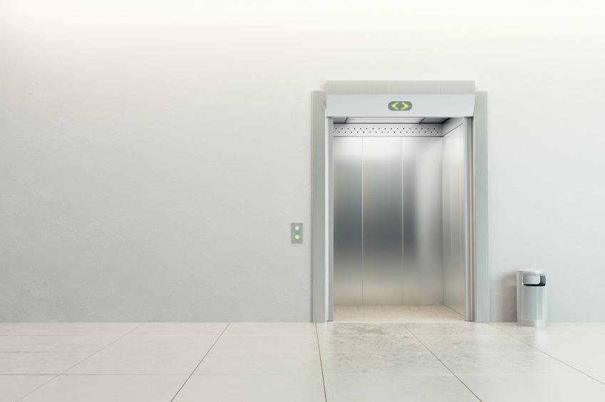
Vision
Competitive Edge
Customer Focus
Manage Cash
Work Hard

Slide 13
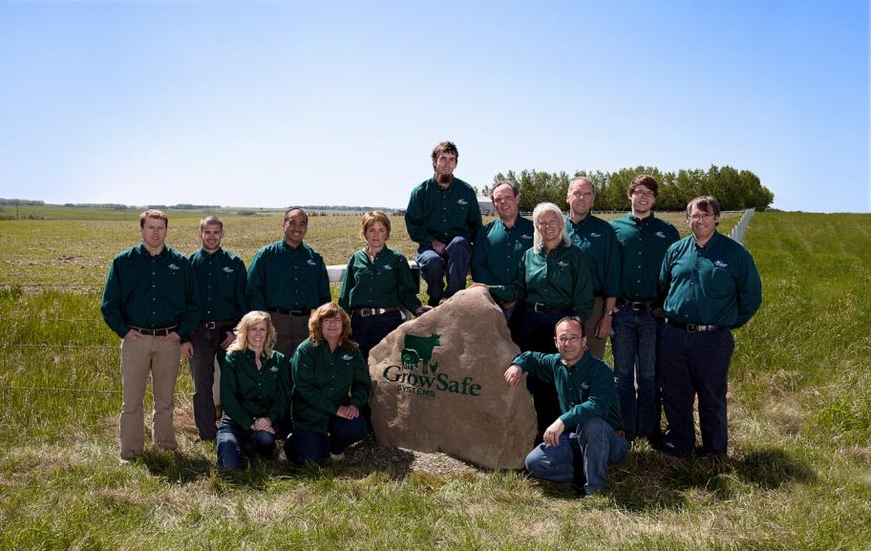
Build a Great Team!

Slide 14

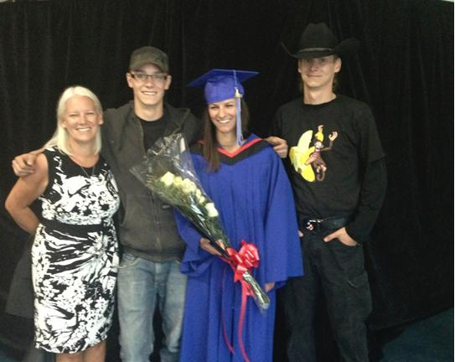
Remember what’s important
Kabul Afghanistan 2013
Advance the next generation

Slide 15
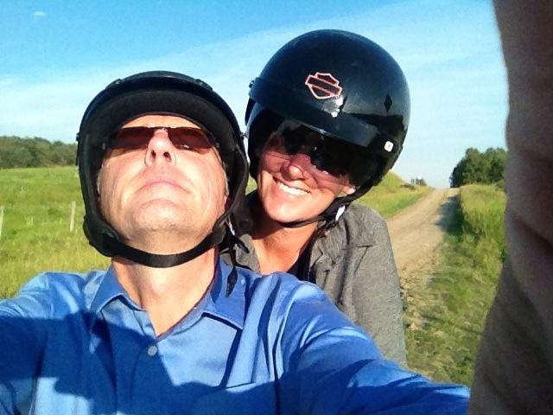
Make Mistakes
Take Risks
Learn Something New
Love What You Do!
als@growsafe.com

